Slide 1
Tries and LCP
Authors: Prince, Muskan
19th Feb ‘23

Slide 2
The Problem

Slide 3
Numbers, Numbers, Numbers
Dealt with numbers only!
Strings, more practical
No time for hashing collisions
Faster, stronger, better (*insert big asterisk here)

Slide 4
The Variants

Slide 5
Linear Bros
Stack : WE CAN DO BETTER!
Queues : No different than stack

Slide 6
Big Linear Bros
Linked List : We don't want this!
Prince
Print
Print

Slide 7
Graph?
Remember? Low Auxiliary space?
Or low time complexity
Or that graphs are complex structures?
Or that I am not well versed in graphs!

Slide 8
Tree: The Messiah

Slide 9
The Tree Variants
Binary Limited by the k in k-ary
AVL Same as binary trees
RB Trees Funny
B-Trees Repetitive
B Search Repetitive

Slide 10
Tries

Slide 11

This Guy
Edward Fredkin
Trie from RETRIEVAL
The stupidest name. /’tri:/
Later changed to /’tra𝚰/

Slide 12
Basic Idea

Slide 13


Slide 14
Performance
Olog(n*m) [ n = no. of strings, m = avg. length of strings]
No repetitions
No fextra fields
No collisions
Best O(n) algo!

Slide 15
The Project
Least Common Prefix using Tries
Autocomplete using trie (*sort of)

Slide 16
Longest Common Prefix
Musk | Muskan | Muskellunge
ObiWan | Abhinawan | Swan

Slide 17
The Code

Slide 18
C makes it easy to shoot yourself in the foot; C++ makes it harder, but when you do it blows your whole leg off.

Slide 19
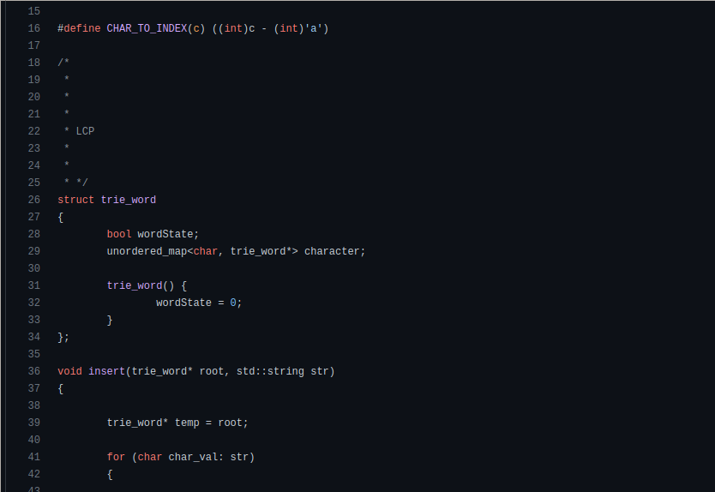
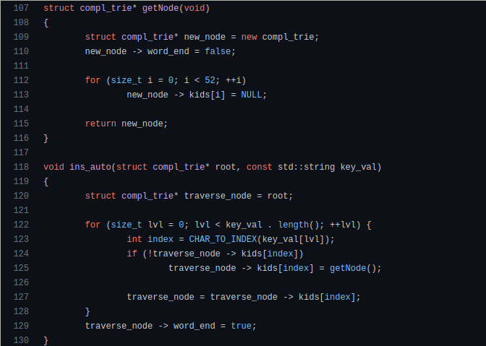
A Preview

Slide 20
LCP Pseudo Explanation
Create original copy of root
3. Loop through the sub nodes only if wordState is false or node has only 1 child
4. Add the current character to previous iteration
2. Create copy of root
5. Assign iterator in map to go through each characters

Slide 21
Autocomplete Pseudo Explanation
Create original copy of root!
3. If the index is leaf, exit!
2. Calculate character index and iterate until array[index] is not reached!
Else, from index 1 or array, add current character to previous iteration

Slide 22
Guide to LCP make

Slide 23
Common Pitfalls And Hacks Implemented
Common Pitfalls
Use of standard iterator for non-linear data structure
Inserting more than specified!
Not checking edge cases
Substandard function implementations
Hacks
Use of Regex for insertion files
Use of public domain files for storage

Slide 24
FAQ
No, Regex is compiled! The search string is in no way compiled or parsed here!
Recursive searching for each node and each hashmap key.
Auto automatically assigns an iterator or complex type
Autocomplete is a general sense but not a fully fledged system for completion!
Is it Regex?
How does LCP work?
What is Auto 𝚰 in your code?
This is not autocomplete?

Slide 25
Final Words
Expect more documentation
A fully fledged autocompletion on the way
New Perl Implementation

Slide 26
Hold no bars!
Questions? Shoot 💪

